Slide 1
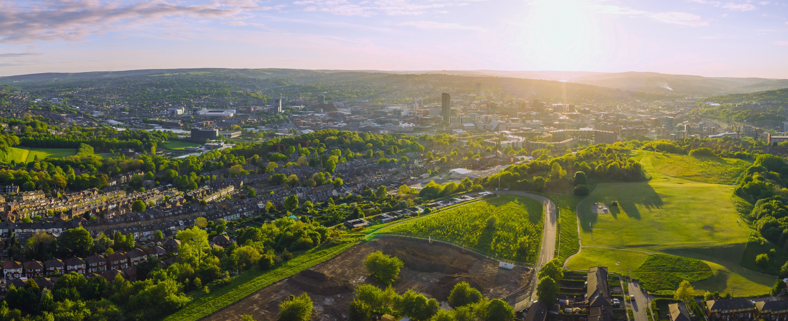

Roadmap to
Net Zero
November 2024

Slide 2
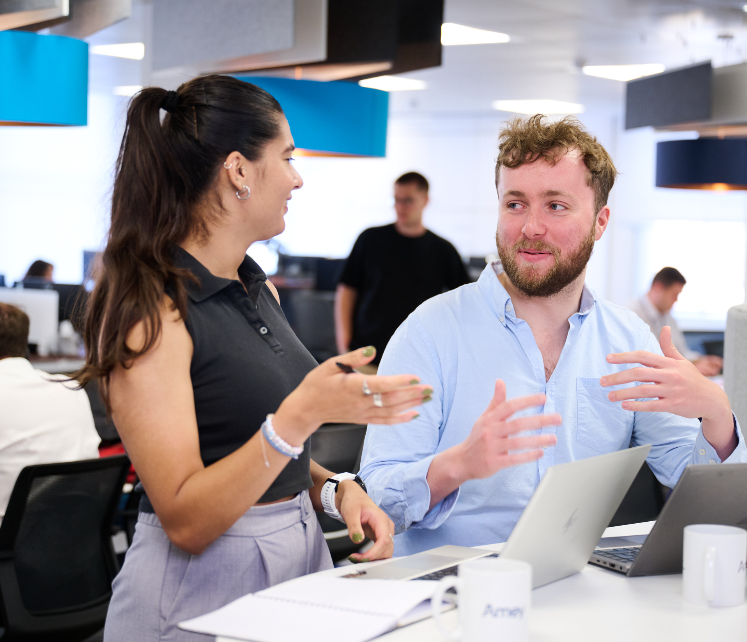
Carbon and climate change
At Amey, we have set a goal to accelerate the change to a resilient and low carbon future.
Our changing climate creates unprecedented challenges for asset owners and operators of critical infrastructure, but it also creates opportunities for positive change.
As the climate emergency becomes more
urgent by the day, we’re working with clients, communities, and industry partners to
tackle it together.
This document shares our approach
and progress towards becoming
a Net Zero organisation.

Slide 3


Our ESG Strategy: four areas of focus
Decarbonisation and
energy efficiency
Reduce and optimise the use of
energy and natural resources across infrastructure management.
Nature
positive
Protect biodiversity and enable
nature recovery so that it can thrive
across the places we work.
Infrastructure
resilience
Upgrade infrastructure so it can
both absorb environmental shocks
and deliver on the energy transition.
Net Zero
organisation
Getting our own house in order
and achieving Net Zero by 2040.

Slide 4


Scoping and measuring our greenhouse gas emissions
We use the GHG Protocol Corporate Accounting and Reporting Standard to measure our emissions.
This table provides a breakdown of all
the scopes that Amey report under and descriptions of what that comprises.
Each year we partner with British Standards Institution (BSI) to verify
our emissions in accordance with
ISO 14064-1 (quantifying and reporting greenhouse gas emissions).
Our Greenhouse Gas Management System documents our method and processes.
Source | GHG Scope | In scope | Out of scope
Energy use - Fuel | 1 | Petrol, diesel, LPG we purchase to fuel our fleet and plant
Energy use - Electricity | 2 | Electricity and gas we purchase to light and heat our buildings | Energy we don't purchase (energy used by Amey people in client offices)
Purchased goods and services* | 3 (Category 1) | Contractor emissions: Petrol, diesel and LPG purchased to deliver services to Amey. The electricity and gas to light and heat their buildings. Goods used: Embodied carbon from the extraction, production and transportation of goods we purchase
Fuel and energy related activities (not included in Scope 1 or Scope 2) | 3 (Category 3) | Emissions associated with extraction, refining and transporting to the forecourt or on-site storage of the fuel we use; and transmission losses on energy we purchase
Upstream transportation and distribution | 3 (Category 4) | Transportation and distribution between our suppliers and the point of use of good we purchase
Waste generated in operations | 3 (Category 5) | Treatment of waste produced by Amey in the delivery of our services | Client waste managed by Amey
Business travel | 3 (Category 6) | Our flights, trains, buses, taxis, cars and hotel accommodation for business travel
Employee commuting | 3 (Category 7) | Our trains, buses, taxis and cars for commuting
* We are currently using financial proxies to support Scope 3 –
Category 1 emission reporting and are working towards using supplier led carbon information as we progress our journey towards Net Zero.

Slide 5


Our Net Zero targets
The Science Based Targets initiative has validated that the science-based greenhouse gas emissions reductions target(s) submitted by Amey UK Limited conform with the SBTi Criteria and recommendations (criteria version 5.1).
SBTi has classified Amey’s Scope 1 and 2
target ambition as in line with a 1.5°C trajectory.
Near-Term Targets
Amey UK Limited commits to reduce absolute Scope 1 and 2 GHG emissions 52.8% by 2030 from a 2019 base year.*
Amey UK Limited also commits to reduce absolute Scope 3 GHG emissions 30.0% within the same timeframe.*
Overall Net Zero Target
Amey UK Limited commits to reach Net Zero greenhouse
gas emissions across the value chain by 2040.
Long-Term Targets: Amey UK Limited commits to reduce absolute Scope 1 and 2 GHG emissions 90% by 2040 from a 2019 base year.*
Amey UK Limited also commits to reduce absolute Scope 3 GHG emissions 90% within the same timeframe.*
* The target boundary includes land-related emissions and removals from bioenergy feedstocks.

Slide 6

Our key principles
Our inhouse experts
Group ESG Team with Carbon & Climate Business Partners and Environmental Managers
Professional Environmental and Sustainability Heads, Business Partners, Managers and Advisors – across each of our operational Business Units
Environmentalists and Carbon Practitioners in our Sustainability Solutions Team providing inhouse, multidisciplinary support:
  Environmental assessment and enhancements with the aim of ensuring nature thrives and creating biodiversity gain
  Climate resilience and adaptation, with the aim of reducing carbon emissions and supporting climate change resilience
BREEAM Infrastructure and
Energy Assessors
Chartered Mechanical and
Electrical Engineers, Civil and
Structural Engineers and Architects
Data Analysts providing Advisory Services and Digital and Data Solutions
Fleet and Procurement Team
To achieve our targets, we will
follow these key principles:
Reduce
Our energy consumption, becoming more
efficient in delivering services
Transition
Our energy use to low carbon alternatives, with a focus on eliminating fossil fuels from vehicles and plant
Innovate
The use of tools and materials in our design
and operations, working to assess and identify sustainable low carbon alternatives
Engage
Our customers, industry and suppliers,
ensuring circular economy principles are
driven through the supply chain.

Slide 7
Our Net Zero action to date
2019
2020
2021
2022
2023
2024
Realised a 5% absolute reduction on Scope 1 and 2 emissions (over 2,000 tCO2e) from 2016 baseline Set our new baseline for Carbon Targets Mobilised a fleet of 22 Nissan e-NV200 electric vehicles, and installed 21 electric vehicle charging points across our depots in Sheffield | Became signatories to the Pledge to Net Zero Removed all traditional internal combustion engine vehicles from the Company Car Choices List Increased the cycle to work certificate limit from £1000 to £3000 Transitioned our energy procurement to 100% renewable energy. | Committed to develop proposed SBTi targets Published our first 'Roadmap to Net Zero’ plan Launched our Carbon employee ideas generation campaign – Springboard Trial of biofuel-based fleet Large electric vehicle trial across our operational contracts Commenced anti-idling campaigns to improve local air quality and reduce unnecessary emissions Trial and replacement of diesel-powered welfare units to new eco-hybrid | Achieved BSI ISO14064 Greenhouse Gas reporting and quantification verification of emissions (2019-2021) Developed our Power BI platform for the business to track carbon emissions centrally Progressed the transition to electric fleet and plan Joined the Supply Chain Sustainability School, to support suppliers with their action for Net Zero Introduced need for details/evidence of how and what social value and sustainability benefits suppliers commit to | Achieved BSI ISO 14064 verification of emissions (2022) Progressed approval for SBTi Targets Introduced our ‘EV First’ Company Car Policy Achieved PAS 2028 Carbon Management in the Built Environment (Designer) Achieved ISO 5001 Energy Management System - delivery team, meaning Amey can offer services to clients under Amey wide projects to provide EV charger infrastructure across key depots and sites | Achieved BSI ISO 14064 verification of emissions (2023) Achieved PAS 2080 Asset Owner – Manager and Constructor Approved SBTi Near Term and Net Zero Targets

Slide 8
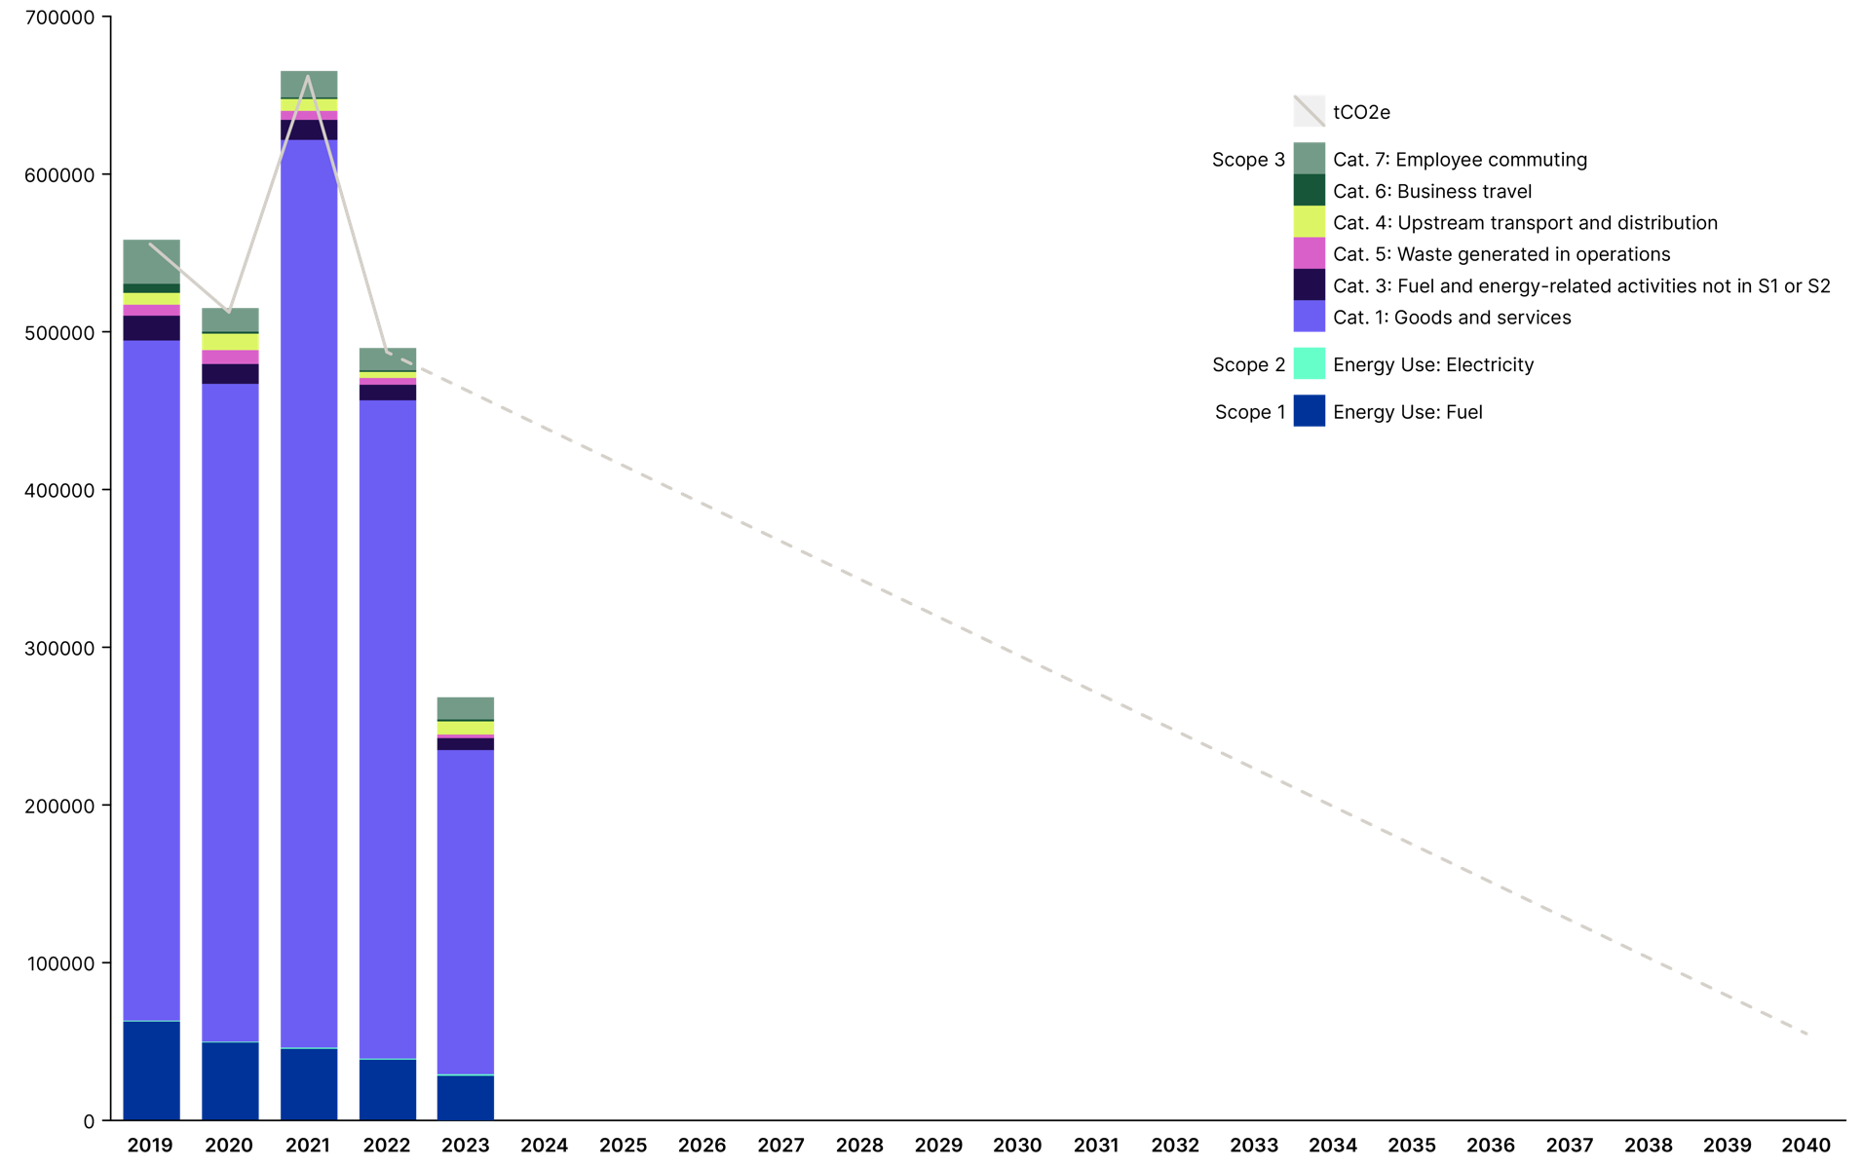
Our greenhouse gas emissions to date and trajectory going forward
This graph shows Amey’s annual emissions since the baseline year of 2019.
The broken line shows the reduction required to meet our 2040 Net Zero target.
Whilst the projected pathway appears as a straight line, Amey anticipates, with the change in how much carbon we emit each year, reducing our impact will be more of a step process.

Slide 9
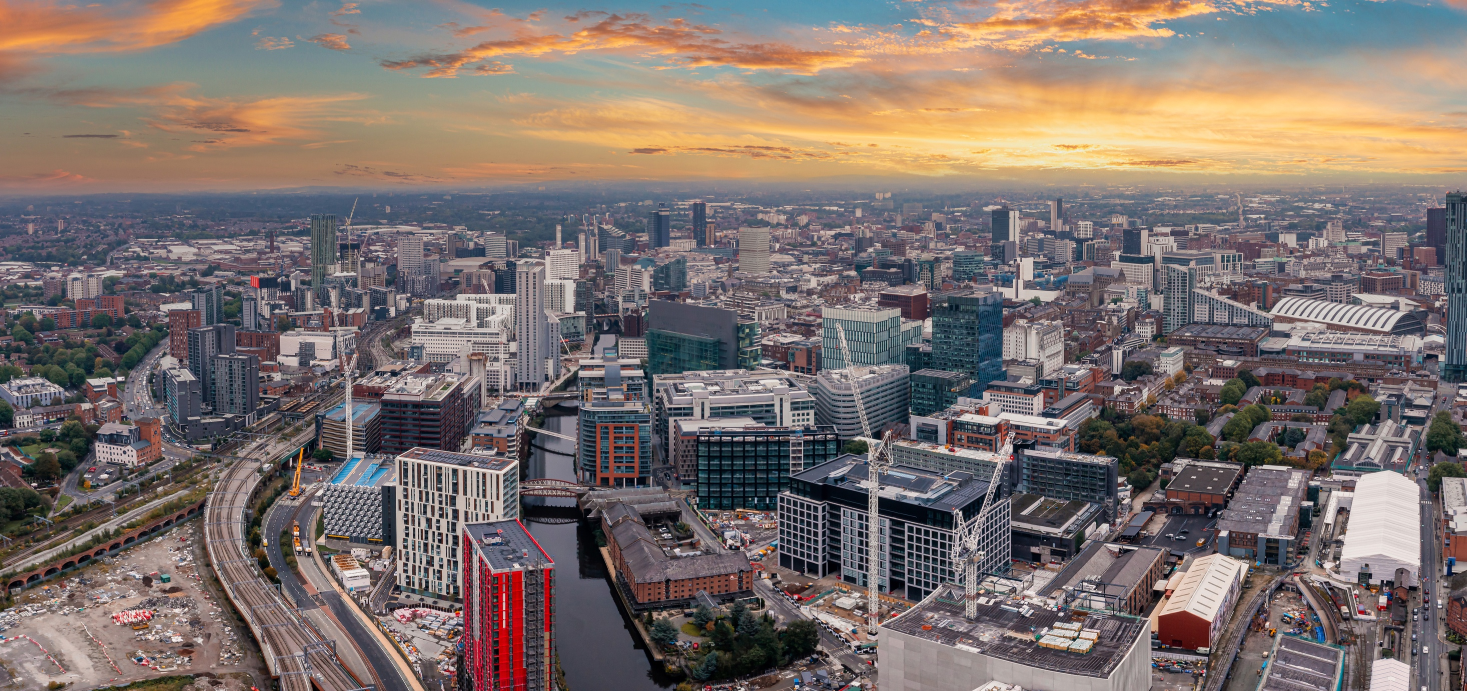
Our verified greenhouse gas emissions performance
Scope and category | Detail | 2019 tCO2e | 2020 tCO2e) | 2021 tCO2e | 2022 tCO2e | 2023 tCO2e
1 | Energy use - Fuel | 62,607 | 49,280 | 45,291 | 38,477 | 28,313
2 | Energy use - Electricity | 472 | 430 | 707 | 604 | 957
3 (Category 1) | Goods and services | 430,346 | 416,227 | 574,370 | 416,474 | 205,474
3 (Category 3) | Fuel and energy related activities (not included in Scope 1 or Scope 2) | 15,765 | 12,720 | 12,776 | 9,973 | 7,616
3 (Category 4) | Upstream transport and distribution | 6,894 | 8,673 | 5,515 | 4,158 | 2,211
3 (Category 5) | Waste generated in operations | 7,492 | 10,439 | 7,641 | 3,909 | 8,445
3 (Category 6) | Business travel | 5,715 | 1,268 | 861 | 942 | 1,196
3 (Category 7) | Employee commuting | 27,927 | 14,919 | 16,772 | 14,131 | 13,999
 |  | 557,218 | 513,957 | 663,934 | 488,669 | 268,211

Slide 10
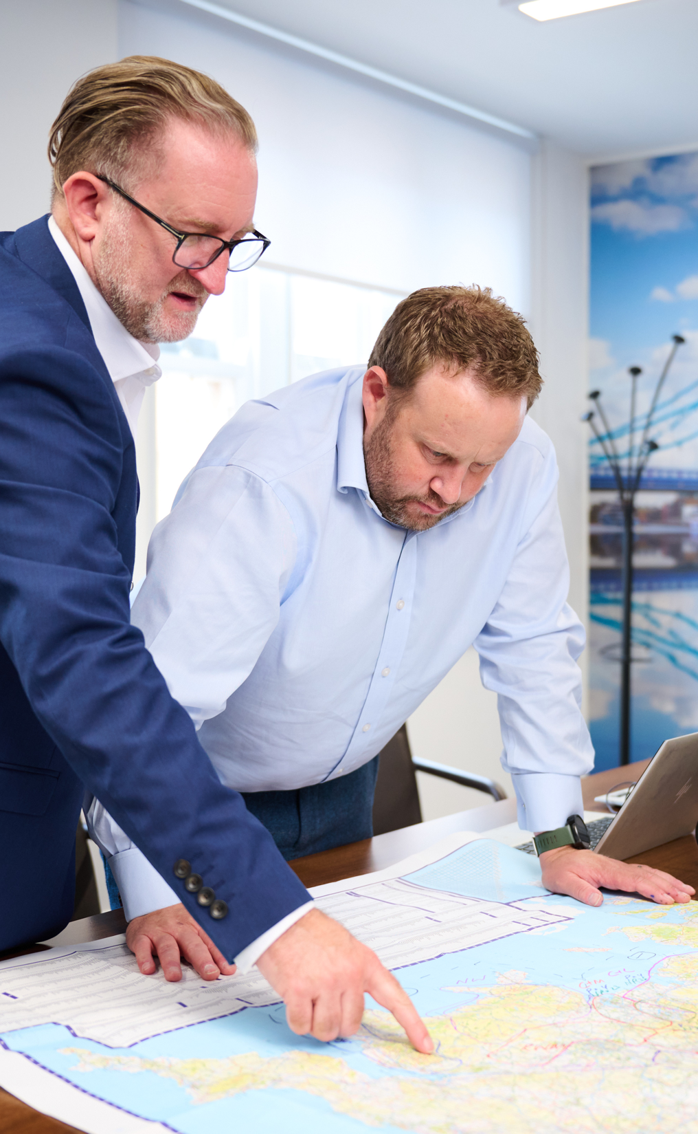
Supporting our teams
We have introduced a range of tools to support our teams to raise their
awareness and competency around carbon and climate change.
Resources for employees and supply:
Introduction to Climate Change
In 2022 100% of our senior leadership team undertook this e-learning module.
Carbon literacy
In 2021 1,400+ Amey Consulting employees completed our ‘Project Carbon Reduction’ e-Learning module, reinforcing our focus on tackling climate change throughout the lifecycle of designs.
Project Carbon Challenge
To further accelerate our provision of low carbon solutions our Consulting teams piloted our new Project Carbon Challenge. This promotes best practice and encourages all members of our team to challenge traditional approaches, specifications, processes and behaviours.
Wider resources we provide:
Sustainability Learn
at Lunch Sessions
Positive environmental
and social change
Carbon Awareness
Delivered to both operational and client teams by our carbon, environment and sustainability professionals – as required.
Institute of Environmental
Management & Assessment (IEMA)
Accredited carbon training delivery across our value chain

Slide 11

Carbon and climate change regulation relevant to Amey
Beyond Amey’s own ambitions to achieve Net Zero,
we support and comply with the following key climate
change and carbon reporting disclosures:
The UK government’s Streamlined Energy and Carbon Reporting (SECR) policy was implemented on 1 April 2019, when the Companies (Directors’ Report) and Limited Liability Partnerships (Energy and Carbon Report) Regulations 2018 came into force. It requires Amey to share energy use and carbon emissions information in their annual reports.
The Energy Savings Opportunity Scheme (Amendment)
Regulations 2023, requires Amey to carry out energy audits
and identify energy saving measures.
Procurement Policy Note 06/21 Taking Account of Carbon in the
procurement of major government contracts - requires Amey when
bidding for government contracts to commit to achieving Net Zero
by 2050 and publish a Carbon Reduction Plan.
The Companies (Strategic Report) (Climate-related Financial Disclosure) Regulations 2022 (SI 2022/31) is a statutory instrument, which came into
force in April 2022 and introduced additional disclosure requirements
into the Companies Act 2006. Amey will first disclose against
this in the 2023 Annual Report.
Please refer to Reports, Statements & Certificates on our website.

Slide 12

Voluntary initiatives we support
Amey support a range of voluntary initiatives,
which alongside the wider sectors in which we operate
aim to raise the commitment and action for climate change
Science Based Target Initiative
A global initiative that helps companies set science-based
emissions reduction targets and drive sustainable growth.
Amey has established SBTi’s.
Pledge to Net Zero
Established to commit organisations from the environmental sector to
take a leadership role in the transition to a Net Zero carbon economy.
UN Global Compact
A voluntary initiative based on CEO commitments to implement
universal principles to take steps to support UN SDGs.
PAS 2080
A global standard for managing carbon within the
built environment. We have achieved designer
certification from British Standards Institution (BSI).
ISO 14064-1
A global standard for quantifying and reporting greenhouse gas emissions. We received verification of our carbon footprint from 2019 to 2022 from the BSI as part of our commitment to achieving Net Zero.

Slide 13

Supporting our clients with decarbonisation and energy transition
In a world where the climate challenge grows more urgent by the day, transitioning to a sustainable, low-carbon energy system is no longer an option but a necessity.
We’re helping to address these challenges through innovation,
drawing on our world-leading data analytics capabilities to find new solutions. We combine cutting-edge technology, strategic planning,
and a collaborative approach to deliver roadmaps that meet needs
of today while paving the way for a sustainable future.
Some of the areas we are working on include:
Net Zero strategies and roadmaps for buildings,
estate, and infrastructure projects
End-to-end climate-resilient, low-carbon design,
build and operations of new infrastructure
Data strategies to generate actionable insights,
drive decisions and integrate decarbonisation plans
Whole life carbon assessments and management aligned with PAS 2080
Novel nature-based solutions to lower carbon emissions,
improve biodiversity and create new community spaces
Please refer to our website to find out more.

Slide 14

For more information, please visit amey.co.uk

